Slide 1

Bank Locker Security System using Android Application
Mrudul Chaudhari_11
Siddhesh Thakarkar_56
Prathamesh Tiwari_57
Guided By:- Mr. Vikrant A. Agaskar

Slide 2
Introduction
The objective of this project to design a “BANK LOCKER SECURITY SYSTEM USING ANDROID APPLICATION” by using Android phone, Bluetooth module and android application. User has to just press a button on the Application present in the mobile in order to open or close the locker which is very easy and safe for the user.
Everything is automated which reduce the risk factor.
Flexibility in generating of information.
Quick retrieved and maintenance of data.
Highly accurate.
User satisfaction

Slide 3
Problem Statement
The traditional methods used by most banks rely on manual locks and PIN numbers/passwords, which are not completely secure. Still, many banks struggle to prevent illegal access and break-ins, and to prevent disclosure of secret information. Still, many banks struggle to prevent illegal access and break-ins, and to prevent disclosure of secret information. These are all problems with traditional safe deposit boxes and lead to bank robberies. The security of these safe deposit boxes must be ensured and verified by strong authentication mechanisms to limit unauthorized access .Still , many banks struggle to prevent illegal access and break-ins, and to prevent disclosure of secret information. These are all problems with traditional safe deposit boxes and lead to bank robberies .In our project, we implement a bank locker security system based on an Android application using an Ardiuno UNO board and a Bluetooth module, which gives us more security than traditional bank locker security systems that use keys for their bank accounts. The project is completely based on the operation of the servo motor which is mainly used as a system to open the lock.

Slide 4
Aim & Applications
To avoid the limitation of current system it’s necessary to design and develop a new system which have the following benefit and the existing system.
Bank security system
Home security system
It is use for protection and safety purpose
Industrial security system
Door Lock security system
High accuracy in terms of security.
No one can hack or crack the system because of using the Android App.
It is easy to use and required no special training and equipment.

Slide 5
Advantages
The proposed system due to the use of hardware’s makes it more faster and prominent for the user.
Transfer of information from Application to Servo motor become easier and faster.
Managing and maintaining data becomes easier and cost effective due to very high amount and reliability of storage space available in the proposed system.
Customer services can not only be satisfied but also enhanced to the extent that one can open or the closer the locker anytime.
No one can hack or crack the system because of using the Android App.
It is easy to use and required no special training and equipment.

Slide 6
Methodology & Implementation
In this project we propose a Arduino, Application & Bluetooth based secure access which can provide a sophisticated locker system for banks. This system contains Arduino UNO Board, Bluetooth module & Servo Motor. Basically, we are using the servo motor as a door lock which is directly connected to the Arduino board with code implemented in it. With the help Bluetooth module, the servo motor rotates considering the order of Android Application through which Bluetooth is connected. As per the user presses the button on the Application, the door gets open and closed on the users order.

Slide 7
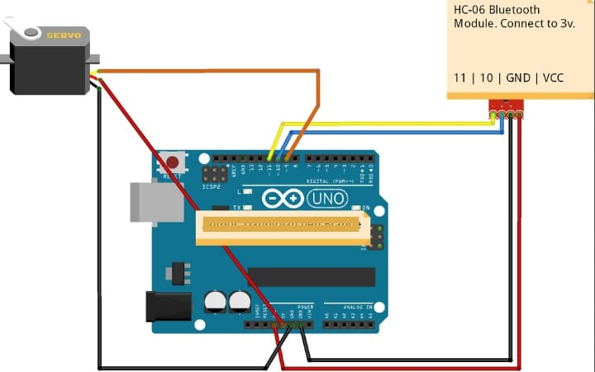
Block Diagram

Slide 8
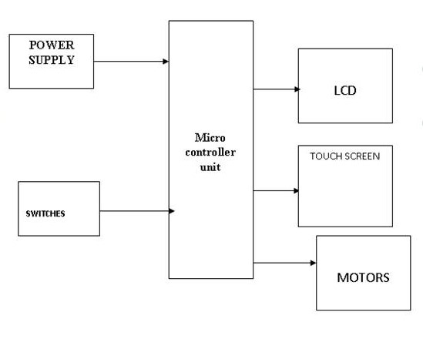
Workflow of System

Slide 9
Hardware & Software Requirements
ARDUINO UNO
Minimum 64 MB RAM (128 MB Desirable) at Computer
MICRO SERVO MOTOR
POWER SUPPLY(POWER BANK/ 5V BATTERY0
BLUETOOTH MODULE ( BLUETOOTH HC-05)
SET OF JUMPER WIRES(MM/FF/MF)
ANDRIOD PHONE
USB CABEL
ARDUINO IDE
SERVO MOTOR CONTROL ANDROID APP
WINDOWS OR LINUX SOFTWARE

Slide 10
CONCLUSION
This paper solution is for highly secured reliable Bank locker Security system. The system will effectively detect and control unauthorized access by considering safety of the bank locker rooms. It will convince the bank customers to use system and hence defend their valuable things from robber and also any harm. This system is used where top level security is needed. The future enhancement to this work could be done by adding some more aspect such as face recognition. Therefore it improved the reliability of bank locker and unauthorized access will be minimized. The enhancement could be further applied to identify the illegal entrance.

Slide 11
THANK YOU

